Slide 1
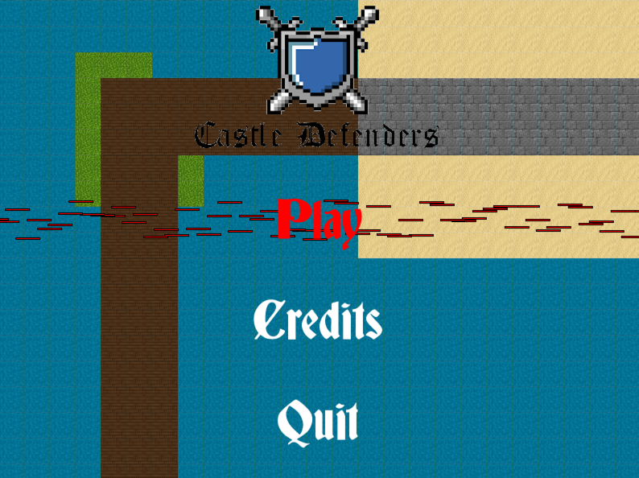
Castle Defenders
By: Brady Jessup and Cole Traynor

Slide 2
Gameplay
Genre: tower defense, strategy game
Objective: hold off attacking enemies from destroying your castle.
Goals: defeat various enemy waves and final boss round.
Resources: gold used to buy towers and limited time to plan out defense.

Slide 3
Tower types
1: basic defense tower, increased damage.
2: freezing tower, slows enemies.
3: poison tower, damage over time.
4: amplification tower, reduces armor of enemies.
5: snare tower, stuns enemies for short period of time.

Slide 4
Enemy types
Slimes: slow moving, average health, spawn in large numbers
Goblins: average speed, increased health
Phoenixes: increased speed, low health, flies over defenses
Final Boss: destroys any tower in the way of a direct path to your castle.
Also has increased health and lower speed.

Slide 5
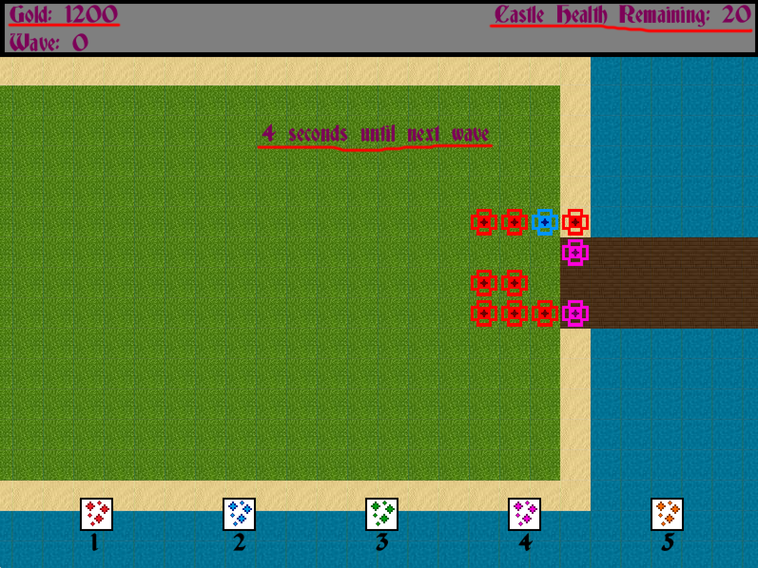
Resources
Gold: used to purchase towers
Health: remaining mobs you can allow through
Time: limited time available to build towers

